Slide 1

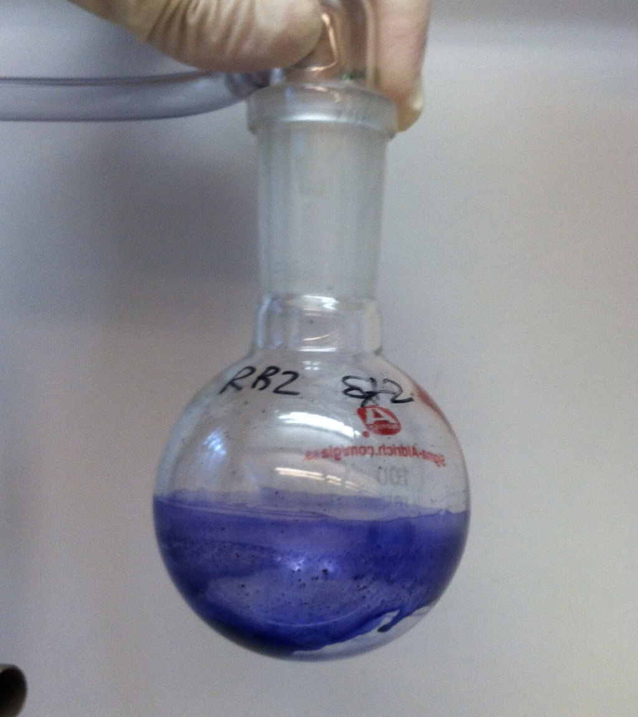
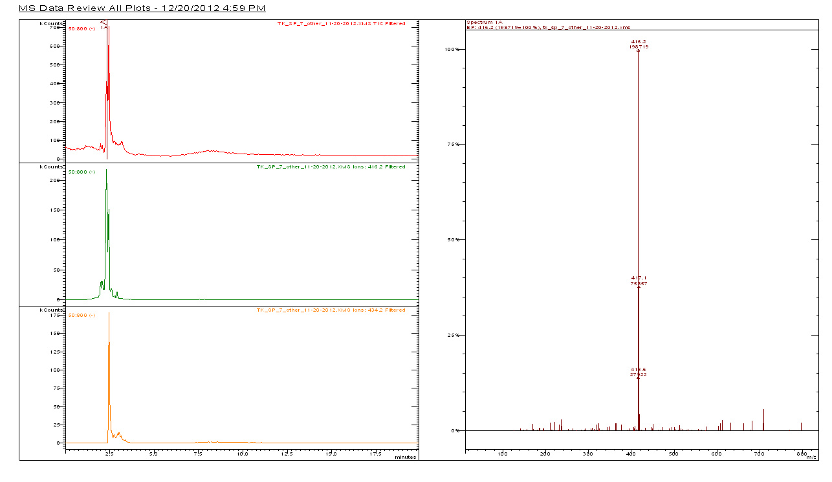
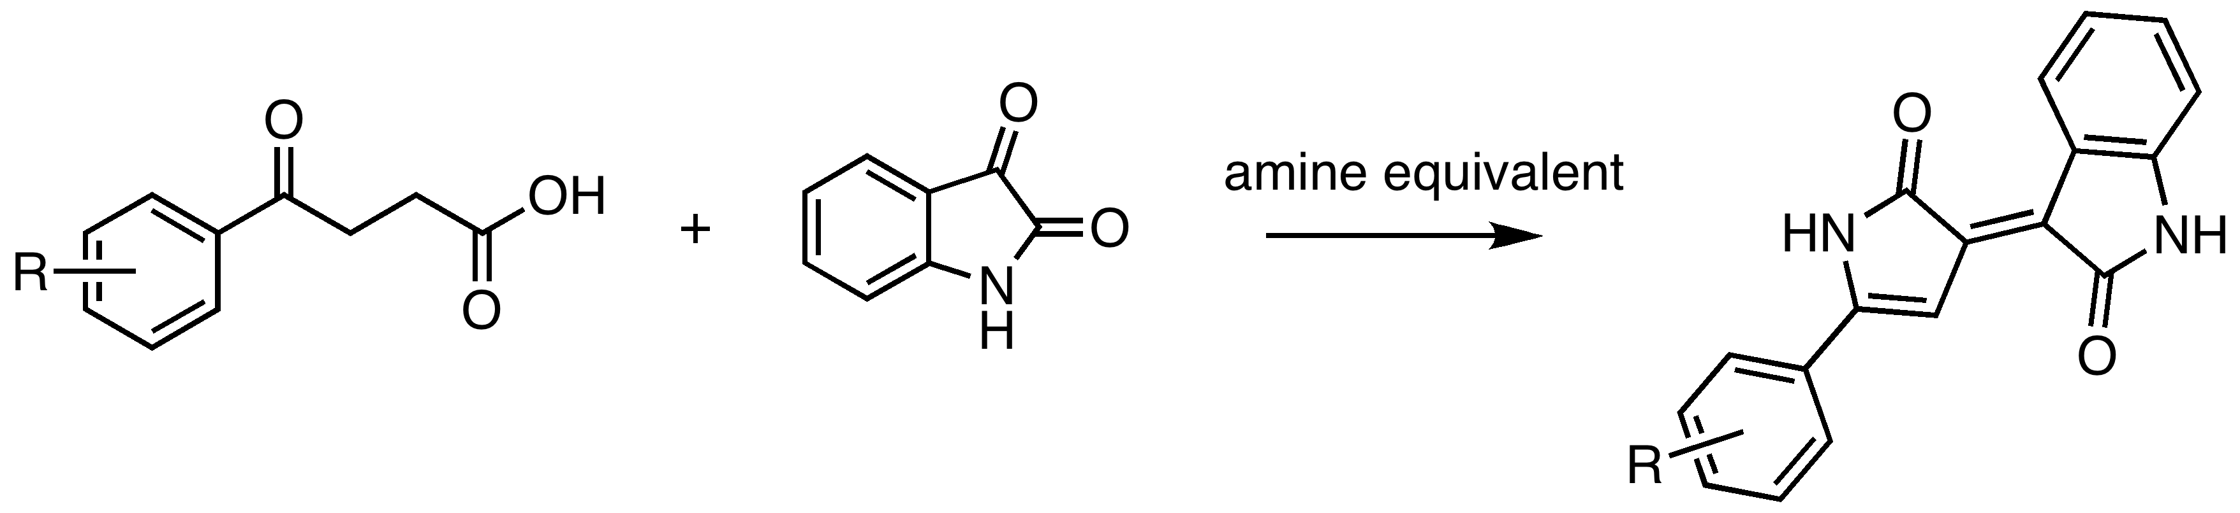
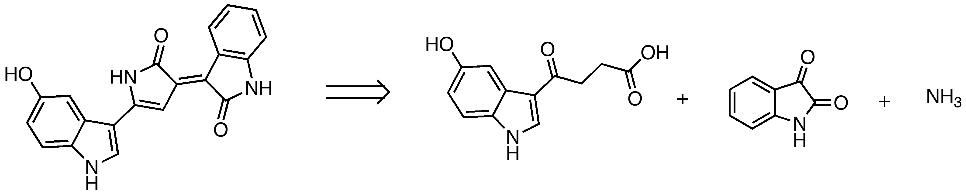

Progress towards the Total Synthesis of
the Anti-microbial Bacterial Pigment Violacein and its Derivatives
Thant Ko Ko, Matthew Norman, Ingrid Stolt, Brooke A. Jude§, and Emily C. McLaughlin*
Chemistry Program, Bard College, Annandale-on-Hudson NY 12504
§Biology Program, Bard College, Annandale-on-Hudson NY 12504
Abstract: Violacein is a purple bacterial pigment produced by several strains of Gram-negative bacteria species including Chromobacterium violaceum and Janthinobacterium lividum. A member of bisindole alkaloid natural product family, violacein is biosynthesized from two-molecules of L-tryptophan mediated by an operon consisting of five genes. It has demonstrated promising anti-microbial properties including anti-bacterial, anti-fungal, anti-viral and anti-tumoral activities. Despite the extensive research investigating biosynthesis of violacein for its potential biological activities, the synthesis of violacein by chemical means has not been widely explored. Two previous reports on chemical synthesis of violacein involved step-wise addition of two indole subunits to the central 5-membered pyrrolidone ring. These methodologies had some disadvantages including the need for preparation of specific starting materials and low yields in each step of the synthesis. Our work in this area has focused on an efficient preparation of the violacein synthetic scaffold based on a new three-component pyrrolidone cyclization. We are investigating the mechanistic details of this reaction and optimizing the solvent and temperature conditions while working towards the total synthesis of violacein and its analogs.
Introduction
Synthetic Pathway
Characterization
Bacterial secondary metabolism produces characteristically diverse bioactive molecules through highly complex regulatory mechanisms. One class of secondary metabolites includes bacterial pigments, which give distinct color to bacterial colonies, and in many cases, contribute to disease pathogenicity by interfering with host immune system. Violacein is a
purple bacterial pigment produced by several strains of bacteria at high cell density likely as a cellular response to quorum sensing. Extensive research on violacein in the past decade has resulted in better understanding of genetic pathways involved in its biosynthesis and the discovery of its interesting biological activities. On the contrary, there have been only a few reports in the literature on chemical synthesis of violacein to date. In this project, we have successfully developed an efficient and concise synthetic scaffold for synthesizing violacein, and we are currently optimizing the solvent and temperature conditions while investigating the mechanistic details of this new methodology.
NH
NH
A
B
C
Biosynthesis of Violacein
Proposed Mechanism
Balibar, C. J.; Walsh, C. T. Biochemistry 2006, 45, 15444–15457.
Conclusions
Proposed intramolecular 1,2 indole rearrangement mediated by VioE
Formation of the cyclization product is observed in reactions performed in high boiling solvents.
Our results suggest that we have successfully developed an alternative method for preparing the violacein scaffold in four synthetic steps.
Pyrrolidone cyclization has been confirmed but a thorough characterization by NMR is desirable.
Cyclization:
Future Work
Ryan, K.S; Drennan, C.L. Chem Bio 2009, 16, 351-364.
We are currently optimizing the purification of the final product of cyclization and will then proceed with debenzylation to obtain deoxylviolacein.
Expansion of the use of variably substituted indoles could easily lead to the preparation of a library of violacein analogs.
Synthetic Methodology
Base | Electrophile | Solvent | Temperature | Time | Method | Product
NH₄OAc | Benzyl-isatin | Xylenes | 139ºC | 10h | Reflux | 3b
NH₄Cl | Benzyl-isatin | Xylenes | 139ºC | 10h | Reflux | No reaction
NH₄OAc | Benzyl-isatin | Xylenes | 150ºC | 5h | µwave | 3b
NH₄OAc | Isatin | Xylenes | 150ºC | 5h | µwave | 3a
NH₄OAc | Benzyl-isatin | THF | 150ºC | 7h | µwave | No reaction
NH₄OAc | Benzyl-isatin | DCE | 150ºC | 7h | µwave | No reaction
NH₄OAc | Benzyl-isatin | Toluene | 150-165ºC | 7h | µwave | 3b
NH₄OAc | Benzyl-isatin | Chlorobenzene | 150-165ºC | 7h | µwave | 3b
Acknowledgements
Abd Alla, M. M., et. al. Revue Roumaine de Chimie 1980, 25, 1549–1560.
A More Efficient Preparation of the Violacein Scaffold:
Special thanks to:
Alexandra Bettina, Bard College ’10
Joshua Tanner, Bard College ‘12
Retrosynthesis:
Contact information:
Emily McLaughlin: mclaughl@bard.edu
Thant Ko Ko: tk3123@bard.edu

